Slide 1
Presentation on Science Fiction
Presented by
Ajut Dangol

Slide 2
Fiction
Type of literature that is based on imagination and invention
Allows readers to escape into different worlds and experience different characters' lives, emotions, and points of view.
Includes genres such as novels, short stories, plays, and poetry.
Categories of fiction are science fiction, fantasy, horror, romance, and many others.

Slide 3
Science fiction
Genre of fiction that explores the possibilities of science and technology, often set in the future.
It innovates new casual relationship between facts, evidence and proof in very imagination way.
Found in books, comics, films, television shows, and video games.

Slide 4
What is the first science fiction ever written?
Frankenstein (Mary Shelley)is often considered the first science fiction novel.

Slide 5
Major Themes in Sci fi
Space travel to and from other planets
Time travel to the past and future
Psychological/biological changes to man brought about by scientific changes
Supernormal powers/talents
Battle with aliens life forms

Slide 6
Why should we study Science Fiction?
Entertaining
Makes the audience wonder “What if?”
Encourages creativity in writing and role-playing.
Introduces students to a new literary genre
Teaches lessons about the value and dangers of advanced technology.
Enhances imagination.

Slide 7
Importance of Science friction in Computer Science
Help to spark the imagination of researchers and developers,
Led to the creation of new technologies and advancements in the field.
Helping to inform the development of responsible and sustainable practices in the field of computer science
Many science fiction stories have depicted advanced technologies such as artificial intelligence, and virtual reality, and these ideas have later been developed into real-world technologies.
Notes:
Science fiction has played an important role in the development of computer science by inspiring and influencing the creation of new technologies.

Slide 8
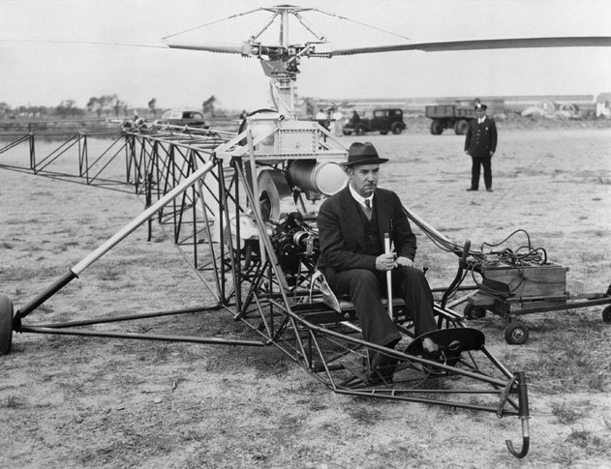
Inventions and innovations of computer science inspired from Sci-Fi
Helicopter Igor Sikorsky was inspired by a Verne book, ”Clipper of the Clouds”

Slide 9
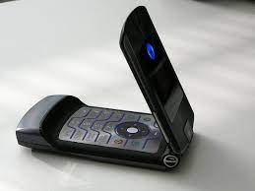
Flip phone Developed by Motorola, inspired from “Star Teck”

Slide 10
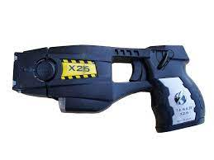
Taser NASA physicist Jack Cover invented it, inspired from “Tom Swift and His Electric Rifle”

Slide 11
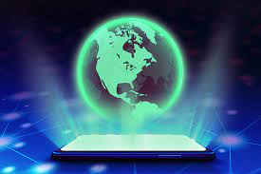
Holographic Communication inspired from “Star Wars” and developed by Ostendo Technologies

Slide 12
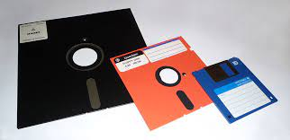
Floppy disk and USB Drives inspired from “Star Teck”

Slide 13
Sci Fi Moves today
Spiderman
X-men
Avatar
Black Panther
Men in Black
Martian

Slide 14
THE END

